Slide 1
Filled Area Primitives
Standard output primitive in graphics packages is solid color ,patterned polygon area
Polygons are easier to process due to linear boundaries
Two basic approaches to area filling on a raster system
1. Determine the overlap intervals for scan lines that cross the area.
Typically useful for filling polygons, circles, ellipses
2.Start from a given interior position and paint outwards from
this point until we encounter the specified boundary conditions
useful for filling more complex boundaries, interactive painting
system.
Computer Graphics, Nepal College of Information Technology, 2009
1

Slide 2
Filling rectangles
Two things to consider
i. which pixels to fill
ii. with what value to fill
Move along scan line (from left to right) that intersect the primitive and fill in pixels that lay inside
To fill rectangle with solid color
Set each pixel lying on scan line running from left edge to right with same
pixel value, each span from x _{max} to x _{min}
for( y from y _{min} to y _{max} of rectangle) /*scan line*/
for( x from x _{min} to x _{max} of rectangle) /*by pixel*/
writePixel(x, y, value);
Computer Graphics, Nepal College of Information Technology, 2009
2

Slide 3
Filling Polygons
Filling Polygons
Scan-line fill algorithm
Inside-Outside tests
Boundary fill algorithm
11
1
2
3
4
5
6
7
8
9
10
5
6
7
8
9
4
3
1
2
Computer Graphics, Nepal College of Information Technology, 2009
3

Slide 4
Topological Difference between 2 Scan lines
y : intersection edges are opposite sides
y’ : intersection edges are same side
y
1
2
2
y’
1
1
Computer Graphics, Nepal College of Information Technology, 2009
4

Slide 5
Topological Difference between 2 Scan lines
y : intersection edges are opposite sides
y’ : intersection edges are same side
y
1
2
2
y’
1
1
Computer Graphics, Nepal College of Information Technology, 2009
5

Slide 6
Edge Sorted Table
B
y_{C}
y_{B}
x_{C}
1/m_{CB}
C
C’
E
y_{D}
y_{C’}
x_{D}
1/m_{DC}
y_{E}
x_{D}
1/m_{DE}
D
y_{A}
y_{E}
x_{A}
1/m_{AE}
y_{B}
x_{A}
1/m_{AB}
A
1
Scan-Line Number
0
Computer Graphics, Nepal College of Information Technology, 2009
6

Slide 7
Proceed to Neighboring Pixels
4-Connected
8-Connected
(x,y+1)
(x-1,y)
(x,y)
(x+1,y)
(x,y-1)
Computer Graphics, Nepal College of Information Technology, 2009
7

Slide 8
Boundary Fill
Start at a point inside a region and paint the interior outward toward the boundary.
If boundary is specified in a single color the fill algorithm proceeds outward pixel by pixel until the boundary color is encountered
Accepts as input coordinates of an interior point (x, y) a fill color and boundary color.
Starting from (x, y) the procedure tests neighboring position to determine whether they are of the boundary color.
If not they are painted with fill color and their neighbors are tested
Process continues until all pixels up to boundary color for the area have been tested
Computer Graphics, Nepal College of Information Technology, 2009
8

Slide 9
boundaryFill ()
Retrive intensity of the pixel inside the boundary
If the retreived intensity is not that of the boundary pixels and AND it is
not the fill color
use recursion to plot pixel in all four directions
Computer Graphics, Nepal College of Information Technology, 2009
9

Slide 10
boundaryFill(int x,y,fill_color, boundary_color){
int color;
getpixel(x,y,color)
if(color != boundary_color AND color != fill_color ){
-> setpixel( x,y,fill_color)
boundaryFill( x+1,y,fill_color, boundary_color)
boundaryFill( x,y+1,fill_color, boundary_color)
boundaryFill( x-1,y,fill_color, boundary_color)
boundaryFill( x,y-1,fill_color, boundary_color)
}
}
(x,y+1)
(x,y+1)
(x,y+1)
(x+1,y+1)
(x-1,y)
(x,y)
(x+1,y)
(x+1+1,y)
(x,y-1)
(x+1,y+1)
Computer Graphics, Nepal College of Information Technology, 2009
10

Slide 11
Flood Fill
Filling an area that is not defined within a single color boundary.
In this case replace a specified interior color instead of searching for boundary color value.
Start from specified interior point (x , y) and reassign all pixel values that are currently set to a given interior color with the desired color.
If the area we want to paint has more than 1 interior color , first assign pixel values so that all interior points have same color.
We can then use 8 or 4 connected approach to move on until all interior points have been repainted.
Computer Graphics, Nepal College of Information Technology, 2009
11

Slide 12
floodFill(int x,y,fill_color, original_color){
int color;
getpixel(x,y,color)
if(color == original_color ){
setpixel(x,y,fill_color)
floodFill(x+1,y,fill_color, original_color)
floodFill(x,y+1,fill_color, original_color)
floodFill(x-1,y,fill_color, original_color)
floodFill(x,y-1,fill_color, original_color)
}
}
16777216 16777216 16777216 16777216 16777216
16777215
Computer Graphics, Nepal College of Information Technology, 2009
12

Slide 13
2D Transformations
A point is represented in 2 dimension by its coordinates
These two values are specified as elements of 1 row 2 column matrix
P(x,y)
In two dimension [x, y] In three dimension [x, y, z]
Or alternatively a point is represented by a 2 row 1 column matrix x x
y y
z
A.B not equal to B.A
rotate translate enlarge
composite Matrix = rotate x translate x enlarge (row wise )
composite Matrix = (enlarge x (translate x rotate)) (column wise )
A B Rigid body transformations (no deformation in shaper after transformation)
1 2 2 3 Non Rigid body transformations
3 4 3 4 B A
2 3 1 2
3 4 3 4
Computer Graphics, Nepal College of Information Technology, 2009
13

Slide 14
2D Transformations
Translation
Repositioning an object along a straight line path
from one coordinate location to another
Add translational distance t_{x} , t_{y} to original
coordinate position P(x,y) to move the point to a
new position P’(x’,y’)
t_{y} = 0
x’ = x + t_{x} y’ = y +t_{y}
where the pair (t_{x} , t_{y}) is called the translation vector.
We can write equation as a single matrix equation by using column vectors to represent coordinate points and translation vectors. i.e.
P’ = P = T=
We can write, P’ = P + T
or
= +
Y
P’(x’,y’)
t_{y}
P(x,y)
t_{x}
X
X’
Y’
X
Y
t_{x}
t_{y}
x’
y’
X
Y
t_{x}
t_{y}
Computer Graphics, Nepal College of Information Technology, 2009
14

Slide 15
2D Transformations
Translation
Repositioning an object along a straight line path
from one coordinate location to another
Add translational distance t_{x} ,t_{y} to original
coordinate position (x,y) to move the point to a
new position (x’,y’)
t_{y} = 0
x’ = x + t_{x} y’ = y + t_{y}
where the pair (t_{x} , t_{y}) is called the translation vector.
We can write equation as a single matrix equation by using column vectors to represent coordinate points and translation vectors. i.e.
P’ = P = T=
We can write, P1 = P + T
or
= +
Y
P’(x’,y’)
P(x,y)
T_{y}
T_{x}
X
X’
Y’
X
Y
t_{x}
t_{y}
X’
Y’
X
Y
t_{x}
t_{y}
Computer Graphics, Nepal College of Information Technology, 2009
15

Slide 16
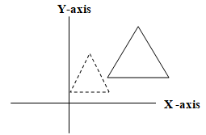
2D Transformations
Scaling
This transformation changes the size of an object
Such that we can magnify or reduce its size
In case of polygons scaling is done by multiplying
coordinate values (x,y) of each vertex by scaling
factors s_{x} s_{y} to produce the final transformed
coordinates (x’,y’).
s_{x} scales object in ‘x’ direction
s_{y} scales object in ‘y’ direction x’ = x * s_{x} y’ = y * s_{y}
P’= P = S =
s _{x} = 2 s _{y} = 2
P’= P * S so
= *
Values greater than 1 for s _{x} s _{y} produce enlargement
Values less than 1 for s _{x} s _{y} ? size of object
s _{x} = s _{y} = 1/2 uniform scaling s _{x} = 5 s _{y} = 2 non uniform scaling
X’
Y’
X
Y
s_{x} ₀
₀ s_{y}
X’
Y’
s_{x} ₀
₀ s_{y}
X
Y
Computer Graphics, Nepal College of Information Technology, 2009
16

Slide 17
2D Transformations
Scaling
This transformation changes the size of an object
Such that we can magnify or reduce its size
In case of polygons scaling is done by multiplying
coordinate values (x,y) of each vertex by scaling
factors s_{x} s_{y} to produce the final transformed
coordinates (x’,y’).
s_{x} scales object in ‘x’ direction
s_{y} scales object in ‘y’ direction
P’= P = S =
P’= P * S so
= *
Values greater than 1 for s _{x} s _{y} produce enlargement
Values greater than 1 for s _{x} s _{y} reduce size of object
s _{x} = s _{y} = 3 uniform scaling s _{x} = 4 s _{y} = 3 non uniform scaling
x’ = x * s_{x} y’ = y * s_{y}
X’
Y’
X
Y
X
Y
s_{x} 0 0 s_{y}
X’
Y’
s_{x} 0 0 s_{y}
X
Y
Computer Graphics, Nepal College of Information Technology, 2009
17

Slide 18
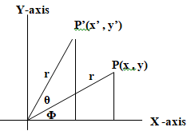
2D Transformations
Rotation (about origin, in ccw, by theta)
Repositioning an object along a circular path in x,y plane
Specify rotation angle ‘θ’ and position (x_{r} ,y _{r}) of rotation point about which the object is to be rotated
+ value for ‘θ’ define counter-clockwise rotation about a point
- value for ‘θ’ define clockwise rotation about a point
If (x,y) is the original point ‘r’ the constant distance from origin, ‘Φ’ the original angular displacement from x-axis.
Now the point (x,y) is rotated through angle ‘θ’ in a counter clock wise direction
Express the transformed coordinates in terms of ‘Φ’ and ‘θ’ as
Cos(Φ + θ) = x’/r or x’ = r.Cos(Φ + θ) ….(i)
Sin(Φ + θ) = y’/r or y’ = r.Sin(Φ + θ) = ….(ii)
x’ = r.CosΦ .Cosθ - r.SinΦ. Sinθ
y’ = r.cos.Φ .sinθ + r.SinΦ.Cosθ
X= r.CosΦ y = r.SinΦ
x’ = x.cosθ – y.sinθ ….(i)
y’ = x.sinθ + y.cosθ ….(ii)
Computer Graphics, Nepal College of Information Technology, 2009
18

Slide 19
2D Transformations
Rotation
Express the transformed coordinates in terms of ‘Φ’ and ‘θ’ as
x’ = r cos(Φ + θ) = r cosΦ. cosθ - r sinΦ. sinθ ….(i)
y’ = r sin(Φ + θ) = r cosΦ. sinθ + r sinΦ. cosθ ….(ii)
We know that original coordinates of point in polar coordinates are
x = r cosΦ y = r sinΦ
substituting these values in (i) and (ii)
x’ = x cosθ - y sinθ y’ = x sinθ + y cosθ
P’ = R. P
using column vector representation for coordinate points the matrix form would be
= *
X’
Y’
cosθ - sinθ
sinθ cosθ
X
Y
Computer Graphics, Nepal College of Information Technology, 2009
19

Slide 20
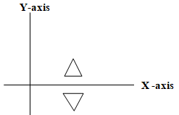
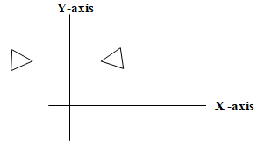
2D Transformations
Reflection
Generates a mirror image of the original object
(i).Reflection about x axis or about line y = 0
Keeps x value same but flips y value of coordinate points
x’ = x and y’ = -y or P’ = R_{fx} * P
= *
x’= 1 y’= -3 x = 1 y = 3
(ii).Reflection about y axis or about line x = 0
Keeps y value same but flips x value of coordinate points
y’ = y and x’ = -x or P’ = R_{fy} * P
= *
x’ = -1 y’ = 3
P(1,3)
X’
Y’
0
0 -1
1
3
P(1,-3)
P(-1,3)
P(1,3)
X’
Y’
-1 0
0 1
1
3
Computer Graphics, Nepal College of Information Technology, 2009
20

Slide 21
2D Transformations
Reflection
Generates a mirror image of the original object
(i).Reflection about x axis or about line y = 0
Keeps ‘x’ value same but flips y value of coordinate points
x’ = x and y’ = -y or P’ = R_{f} * P
= *
(ii).Reflection about y axis or about line x = 0
Keeps ‘y’ value same but flips x value of coordinate points
y’ = y and x’ = -x or P’ = R_{f} * P
= *
X’
Y’
X
Y
X’
Y’
X
Y
Computer Graphics, Nepal College of Information Technology, 2009
21

Slide 22
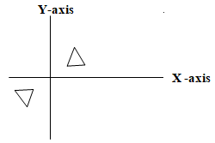
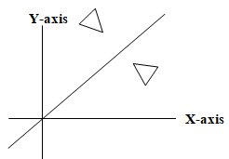
2D Transformations
Reflection
Generates a mirror image of the original object
(iii).Reflection about origin
Flip both ‘x’ and ‘y’ coordinates of a point
=
(iv).Reflection about line y = x
Steps required:
i. Rotate about origin in clockwise direction by 45
degree which rotates line y = x to x-axis
ii. Take reflection against x-axis
iii. Rotate in anti-clockwise direction by same angle
X’
Y’
-1 0
0 -1
X
Y
Computer Graphics, Nepal College of Information Technology, 2009
22

Slide 23
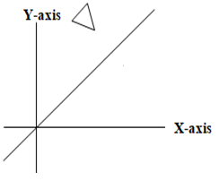
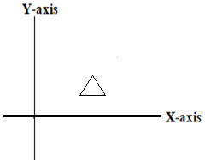
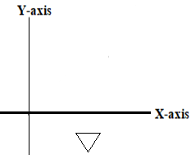
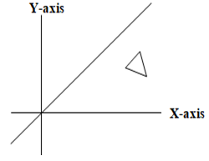
2D Transformations
Reflection
iv).Reflection about line y = x
Steps required:
i. Rotate about origin in clockwise direction by 45
degree which rotates line y = x to x-axis
ii. Take reflection against x-axis
iii. Rotate in anti-clockwise direction by same angle
Composite Matrix (CM) = * *
?
?
?
?
?
?
Computer Graphics, Nepal College of Information Technology, 2009
23

Slide 24
2D Transformations
Reflection
iv).Reflect a point P(1,3) about line y = -x
cm = Rccw. (Rf . Rcw)
Composite Matrix (CM) = * *
P’ = CM . P
= *
x =1 y = 3
x’ = 3 y’ = 1
cosθ sinθ
-sinθ cosθ
1 0
0 -1
cosθ -sinθ
sinθ cosθ
cosθ -sinθ
sinθ cosθ
1 0
0 -1
cosθ sinθ
-sinθ cosθ
X’
Y’
0 1
1 0
1
3
Computer Graphics, Nepal College of Information Technology, 2009
24

Slide 25
2D Transformations
Reflection
iv).Reflect a point P(1,3) about line y = -x
cm = Rccw. (Rf . Rcw)
cm =
Composite Matrix (CM) = * *
P’ = CM . P
= *
x =1 y = 3
x’ = 3 y’ = 1
cosθ sinθ
-sinθ cosθ
1 0
0 -1
cosθ -sinθ
sinθ cosθ
cosθ -sinθ
sinθ cosθ
1 0
0 -1
cosθ sinθ
-sinθ cosθ
X’
Y’
0 1
1 0
X
Y
Computer Graphics, Nepal College of Information Technology, 2009
25
Notes:
Note: here, theta will come in negative value -45 so subtract it from 180 to get 135 and use it for sinθ and cosθ

Slide 26
2D Transformations
Reflection
iv).Reflect a point P(1,3) about line y = -3x
cm = Rccw. (Rf . Rcw)
cm =
Composite Matrix (CM) = * *
P’ = CM . P
= *
x =1 y = 3
x’ = 3 y’ = 1
cosθ sinθ
-sinθ cosθ
1 0
0 -1
cosθ -sinθ
sinθ cosθ
cosθ -sinθ
sinθ cosθ
1 0
0 -1
cosθ sinθ
-sinθ cosθ
X’
Y’
0 1
1 0
X
Y
Computer Graphics, Nepal College of Information Technology, 2009
26
Notes:
Note: here, theta will come in negative value -71.66 so subtract it from 180 to get and use it for sinθ and cosθ

Slide 27
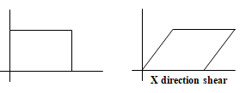
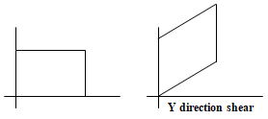
2D Transformations
Shearing (non rigid body transformation)
Distorts the shape of object in either ‘x’ or ‘y’ or both direction
In case of single directional shearing (e.g. in ‘x’ direction can be viewed as an object made up of very thin layer and slid over each other with base remaining where it is)
in ‘x’ direction,
x’ = x + s_{hx} . y
y’ = y
= *
in ‘y’ direction,
x’ = x
y’ = y + s_{hy} . x
= *
X’
Y’
1 s_{hx}
0 1
X
Y
X’
Y’
1 0
s_{hy} 1
X
Y
Computer Graphics, Nepal College of Information Technology, 2009
27

Slide 28
2D Transformations
Composite Transformation
With the matrix representation of transformation equations it is possible to setup a matrix for any sequence of transformations as a composite transformation matrix by calculating the matrix product of individual transformation.
For column matrix representation of coordinate positions we form composite transformation by multiplying matrices in order from right to left.
Composite Matrix (CM) = * *
cosθ sinθ
-sinθ cosθ
1 0
0 -1
cosθ -sinθ
sinθ cosθ
cosθ -sinθ
sinθ cosθ
1 0
0 -1
cosθ sinθ
-sinθ cosθ
Computer Graphics, Nepal College of Information Technology, 2009
28

Slide 29
2D Transformations
Homogenous coordinate
P’ = T + P additive
P’ = R * P multiplicative
P’ = S * P multiplicative
Composite Matrix (CM) = * +
cosθ -sinθ
sinθ cosθ
2 0
0 2
T_{x}
T_{y}
R
P’
S
T
P
Computer Graphics, Nepal College of Information Technology, 2009
29

Slide 30
2D Transformations
Homogenous coordinate
P’ = T + P additive
P’ = R * P multiplicative
P’ = S * P multiplicative
P(2,3) = P (2,3,1) h = 1 plane
P(2,3) = P (4,6,2) h = 2 plane
1 0 T_{x}
0 1 T_{y}
0 0 1
Y
R
P’
S
T
P
X
h = 1 plane
H
Third virtual coordinate axis is added
Computer Graphics, Nepal College of Information Technology, 2009
30

Slide 31
2D Transformations
Homogenous coordinate
P’ = T + P additive
P’ = R * P multiplicative cm = S . R .T
P’ = S * P multiplicative
P(2,3) = P (2,3,1) h = 1 plane = +
P(2,3) = P (2,3,1) h = 2 plane
P’ = T + P
x’ = x + T_{x} = *
y’ = y + T_{y}
1 = 1
x’
y’
1
T_{x}
T_{y}
1
x
y
1
x’
y’
1
1 0 T_{x}
0 1 T_{y}
0 0 1
x
y
1
cosθ -sinθ 0
sinθ cosθ 0
0 0 1
2 0 0
0 2 0
0 0 1
1 0 T_{x}
0 1 T_{y}
0 0 1
Computer Graphics, Nepal College of Information Technology, 2009
31

Slide 32
2D Transformations
Homogenous coordinate
P’ = T + P additive
P’ = R * P multiplicative
P’ = S * P multiplicative
P(2,3) = P (2,3,1) h = 1 plane
P(2,3) = P (2,3,1) h = 2 plane
cosθ -sinθ 0
sinθ cosθ 0
0 0 1
2 0 0
0 2 0
0 0 1
1 0 T_{x}
0 1 T_{y}
0 0 1
Y
R
P’
S
T
P
X
h = 1 plane
H
Third virtual coordinate axis is added
Computer Graphics, Nepal College of Information Technology, 2009
32

Slide 33
2D Transformations
Homogenous coordinate
P’ = T + P additive
P’ = R * P multiplicative
P’ = S * P multiplicative
Composite Matrix (CM) =
cosθ -sinθ 0
sinθ cosθ 0
0 0 1
2 0 0
0 2 0
0 0 1
1 0 T_{x}
0 1 T_{y}
0 0 1
Y
R
P’
S
T
P
X
h = 1 plane
H
Third virtual coordinate axis is added
Computer Graphics, Nepal College of Information Technology, 2009
33

Slide 34
Fixed Point Rotations
A point P(3,2) is required to be shifted down by 2 units, rotated about origin by 45 degrees in anti clock wise direction and scaled by 2 times, what will be the final coordinate of the point after performing these operations?
Composite matrix = S(sx=2,sy=2) . R(theta =45 ccw) .T(tx = 0, ty = - 2)
Composite matrix =
P’ =
P’ =
2 0 0
0 2 0
0 0 1
cos 45 -sin 45 0
sin45 cos45 0
0 0 1
1 0 0
0 1 -2
0 0 1
CM
3
2
1
?
?
1
Computer Graphics, Nepal College of Information Technology, 2009
34

Slide 35
Fixed Point Rotations
A line with end points A(-5,-1) B(-3-4) need to be reflected about line y = -2, what will be the final coordinates?
Steps:
1. Line y = -2 is translated in y direction along with the line to be reflected so that it is aligned with x axis
2. Take reflection of the line about x axis
3. Line is translated back to its original location along with the reflected line
CM = T(tx = 0, ty = -2) . Rfx . T(tx =0 , ty = 2)
P’ = CM . P
A B
A’ B’
P’ =
Y
5
4
3
2
1
-1
-2
-3
-4
1 0 0
0 1 -2
0 0 1
1 0 0
0 -1 0
0 0 1
1 0 0
0 1 2
0 0 1
-5 -4 -3 -2 -1 0 1 2 x
CM
-5 -3
-1 -4
1 1
1 -1
-1 -4
1 1
Computer Graphics, Nepal College of Information Technology, 2009
35

Slide 36
Fixed Point Rotations
Y
5
4
3
2
1
-1
-2
-3
-4
-5 -4 -3 -2 -1 0 1 2 x
1 0 0
0 1 2
0 0 1
1 0 0
0 -1 0
0 0 1
1 0 0
0 1 2
0 0 1
Computer Graphics, Nepal College of Information Technology, 2009
36

Slide 37
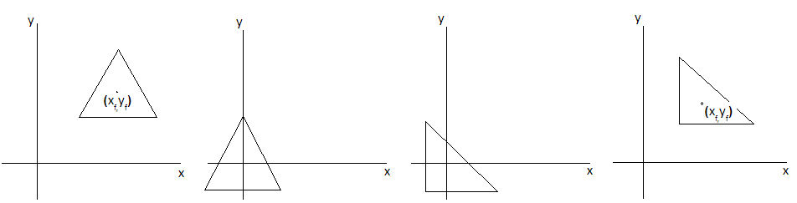
1 ₀ xf 0 1 yf
0 0 1
cos 45 -sin 45 0
sin45 cos45 0
0 0 1
1 ₀ -xf 0 1 -yf
0 0 1
Fixed Point Rotations
CM = T (x_{f,} y_{f}) R T (-x_{f,} -y_{f})
P’ = CM x P
An object is required to be rotated about a fixed point (x_{f,}y_{f})
Steps:
1. The fixed point (x_{f,}y_{f}) along with the the object is translated to origin
2. The object is rotated about origin
3. The fixed point along with the the rotated object is translated back to its
original position (x_{f,}y_{f})
Computer Graphics, Nepal College of Information Technology, 2009
37

Slide 38
Fixed Point Rotations
An object is required to be rotated about a fixed point (x_{f,}y_{f})
CM = T (x_{f,} y_{f}) R T (-x_{f,} -y_{f})
Composite Matrix (CM) =
P’ =
1 0 x_{f}
0 1 t_{f}
0 0 1
cosθ -sinθ 0
sinθ cosθ 0
0 0 1
1 0 -x_{f}
0 1 -y_{f}
0 0 1
CM
x₁ x₂ x₃
y₁ y₂ y₃
1 1 1
Computer Graphics, Nepal College of Information Technology, 2009
38

Slide 39
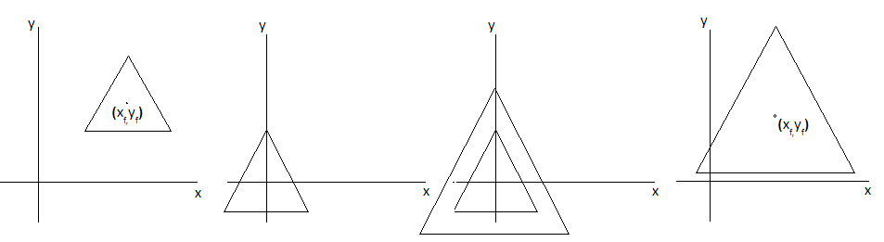
Fixed Point Scaling
An object is required to be scaled about a fixed point (x_{f,}y_{f})
Steps:
1. The fixed point (x_{f,}y_{f}) along with the the object is translated to origin
2. The object is scaled about origin
3. The fixed point along with the the rotated object is translated back to its
original position (x_{f,}y_{f})
s_{x} 0 0 s_{y}
Computer Graphics, Nepal College of Information Technology, 2009
39

Slide 40
Fixed Point Rotations
An object is required to be scaled about a fixed point (x_{f,}y_{f})
CM = ( T(tx,yf). ( S(sx,sy).T(-xf, -yf) ) )
Composite Matrix (CM) =
P’ =
1 0 x_{f}
0 1 y_{f}
0 0 1
s_{x} 0 0
0 s_{y} 0
0 0 1
1 0 -x_{f}
0 1 -y_{f}
0 0 1
CM
x
y
1
Computer Graphics, Nepal College of Information Technology, 2009
40

Slide 41
Exercise
Enlarge a triangle A(1,1) B(5,1) C(3,3) about any fixed point P(3,2) by twice its original size sx = 2 sy = 2
CM = T (tx =3,ty =2) S(sx =2, sy = 2) T(tx = -3, ty = -2)
CM =
P’ = = =
1 0 3
0 1 2
0 0 1
2 0 0
0 2 0
0 0 1
1 0 -3
0 1 -2
0 0 1
cm
₁ ₅ ₃
₁ ₁ ₃
₁ ₁ ₁
5
4
3
2
1
-1 0 1 2 3 4 5 6 7
Computer Graphics, Nepal College of Information Technology, 2009
41

Slide 42
Rotate a triangle A(1,1) B(5,1) C(3,3) about any fixed point P(3,2) by 90 degrees in anti clockwise direction
Steps:
1. Translate the fixed point P(3,2) to origin along with vertices of triangle to be rotated
2. Rotate the triangle by 90 in ccw
3. Translate the fixed point back to its original location along with rotated vertices of triangle
CM = T(tx = 3, ty =2) R T(tx =-3, ty =-2)
CM =
P’ = = =
The final vertices of the triangle after performing the desired transformation are A’(4,0) B’(4,4), C’(2,2)
₁ ₀ ₃
₀ ₁ ₂
₀ ₀ ₁
cos 90 -sin90 0
sin90 cos 90 0
0 0 1
₁ ₀ ₋₃
₀ 1 -2
₀ 0 1
cm
₁ ₅ ₃
₁ ₁ ₃
₁ ₁ ₁
₄ ₄ ₂
₀ ₄ ₂
₁ ₁ ₁
5
4
3
2
1
-1 0 1 2 3 4 5 6 7
Computer Graphics, Nepal College of Information Technology, 2009
42

Slide 43
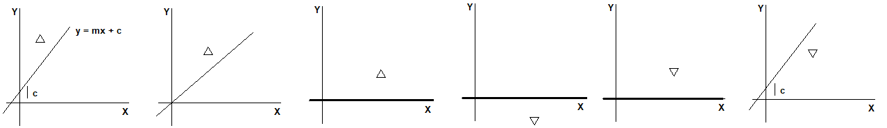
2D Rotations about line y = mx + c
An object is required to be reflected about a line y = mx +c
Steps:
The line is translated so that it passes thru origin
The line is rotated along with the object to be reflected so that the line is aligned with one of the coordinate axes
The object is reflected about that major coordinate axis
The line is rotated back along with the reflected object by the same angle with which it was rotated earlier to align the line with the coordinate axis
The line is translated back along with the reflected object to its original position
Computer Graphics, Nepal College of Information Technology, 2009
43

Slide 44
Fixed Point Rotations
An object is required to be reflected about a line y = mx +c
CM = T(0,c) . Rccw. Rfx . Rcw . T(0,-c)
cm=
P’ =
1 0 0
0 1 c
0 0 1
cosθ -sinθ 0
sinθ cosθ 0
0 0 1
1 0 0
0 -1 0
0 0 1
cosθ sinθ 0
-sinθ cosθ 0
0 0 1
1 0 0
0 1 -c
0 0 1
CM
x
y
1
Computer Graphics, Nepal College of Information Technology, 2009
44

Slide 45
Fixed Point Rotations
A Triangle with vertices A(0,4) B(0,5) C(1,5) is required to be reflected about line
y = 2x + 1 CM = T (tx =0 ,ty =1) . Rccw (??) . Rf (??) . Rcw . T(tx =0 ,ty =-1)
y intercept = 1 tan(theta) = 2 theta = tan-1(2) = xxxxx cos(theta)
x y
0 1
1 3
2 5
cm=
A B C A’ B’ C’
P’ = =
0 0 0
0 1 1
0 0 1
cos(th) -sin(th) 0
sin(th) c0s(th) 0
0 0 1
1 0 0
0 -1 0
0 0 1
Cos(th) sin(th) 0
-sin(th) c0s(th) 0
0 0 1
0 0 0
0 1 -1
0 0 1
CM
0 0 1
4 5 5
1 1 1
Computer Graphics, Nepal College of Information Technology, 2009
45

Slide 46
Exercise
A Triangle with vertices A(0,4) B(0,5) C(1,5) about line y = 2x + 1
CM=
1 0 0
0 1 1
0 0 1
cosθ -sinθ 0
sinθ cosθ 0
0 0 1
1 0 0
0 -1 0
0 0 1
cosθ sinθ 0
-sinθ cosθ 0
0 0 1
1 0 0
0 1 -1
0 0 1
5
4
3
2
1
3 3 4
2 4 3
1 1 1
-1 0 1 2 3 4 5 6 7
Computer Graphics, Nepal College of Information Technology, 2009
46

Slide 47
Exercise
A Triangle with vertices A(2,3) B(3,4) C(4,3) about line y = -x + 2
CM=
1 0 0
0 1 2
0 0 1
cosθ -sinθ 0
sinθ cosθ 0
0 0 1
1 0 0
0 -1 0
0 0 1
cosθ sinθ 0
-sinθ cosθ 0
0 0 1
1 0 0
0 1 -2
0 0 1
5
4
3
2
1
-1 0 1 2 3 4 5 6 7
Computer Graphics, Nepal College of Information Technology, 2009
47

Slide 48
Exercise
A Triangle with vertices A(2,3) B(3,4) C(4,3) is required to be reflected about line y = - x
Theta = tan-1(-3)
CM=
cosθ -sinθ 0
sinθ cosθ 0
0 0 1
1 0 0
0 -1 0
0 0 1
cosθ sinθ 0
-sinθ cosθ 0
0 0 1
5
4
3
2
1
-1 0 1 2 3 4 5 6 7
Computer Graphics, Nepal College of Information Technology, 2009
48

Slide 49
Composite Transformation
Matrix Composition: A single matrix formed by combining a number of transformations or sequence of transformations
The resulting matrix is called as composite matrix.
With the matrix representation of transformation equations it is possible to setup a matrix for any sequence of transformations as a composite transformation matrix by calculating the matrix product of individual transformation.
For column matrix representation of coordinate positions we form composite transformation by multiplying matrices in order from right to left.
i. Two Successive Translation are Additive
Let two successive translation vectors ( t_{x1} , t_{y1} ) and ( t_{x2} , t_{y2} ) are applied to a coordinate position P then
or, P’ = T( t_{x2} , t_{y2} ) . {T( t_{x1} , t_{y1} ) . P} and P’ = {T( t_{x2} , t_{y2} ) . T( t_{x1} , t_{y1} ) } . P
Here the composite transformation matrix for this sequence of translation is
. =
1 0 T_{x2}
0 1 T_{y2}
0 0 1
1 0 T_{x1}
0 1 T_{y1}
0 0 1
1 0 T_{x1} + T_{x2}
0 1 T_{y1} + T_{y2}
0 0 1

Slide 50
Composite Transformation
ii. Two successive Scaling operations are Multiplicative
Let ( s_{x1} , s_{y1} ) and ( s_{x2} , s_{y2} ) be two successive vectors applied to a coordinate position P then the composite scaling matrix thus produced is
or, P’ = S( s_{x2} , s_{y2} ) . {S( s_{x1} , s_{y1} ) . P} and P’ = {S( s_{x2} , s_{y2} ) . S( s_{x1} , s_{y1} ) } . P
Here the composite transformation matrix for this sequence of translation is
. =
iii. Two successive Rotation operations are Additive
Let R(θ₁) and R(θ₂) be two successive rotations applied to a coordinate position P then the composite scaling matrix thus produced is
or, P’ = R(θ₂) . {R(θ₁) . P} and P’ = {R(θ₂) . R(θ₁) } . P
Here the composite transformation matrix for this sequence of translation is
. =
= or R(θ₂) . R(θ₁) = R(θ₁ + θ₂)
s_{x2} 0 0
0 s_{y2} 0
0 0 1
s_{x1} 0 0
0 s_{y1} 0
0 0 1
s_{x2} . s_{x1} 0 0
0 s_{y2} . s_{y1} 0
0 0 1
cosθ₂ -sinθ₂
sinθ₂ cosθ₂
cosθ₁ -sinθ₁
sinθ₁ cosθ₁
cosθ₂.cosθ₁-sinθ₂.sinθ₁ -cosθ₂.sinθ₁-sinθ₂.cosθ₁
sinθ₂.cosθ₁+sinθ₁.cosθ₂ cosθ₂.cosθ₁-sinθ₂.sinθ₁
cos(θ₁+θ₂) - sin(θ₁+θ₂)
sin(θ₁+θ₂) cos(θ₁+θ₂)

Slide 51
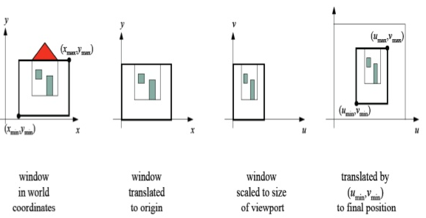
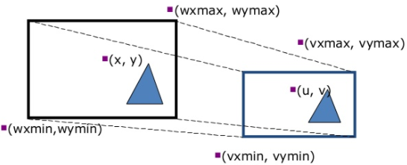
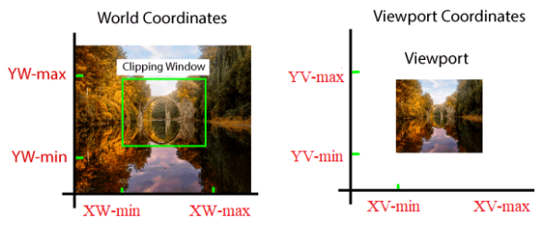
Window and View ports
Computer Graphics, Nepal College of Information Technology, 2009
51

Slide 52
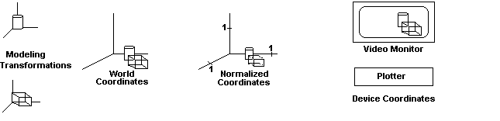
Window and View ports
A rectangular area specified in world coordinates is called a window.
A rectangular area on the display device to which a window is mapped is called a view port.
The window defines what is to be viewed; the view port defines where it is to be displayed.
Often windows and view ports are rectangles in standard position with rectangle edges parallel to coordinate axes
For practical applications we need a transformation to translate and scale window to any size by moving it to specified rectangular area on screen
The mapping of a part of world coordinate scene to device coordinate is referred to as viewing transformation.
Computer Graphics, Nepal College of Information Technology, 2009
52

Slide 53
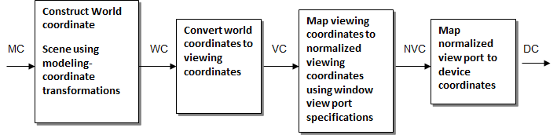
2-D Viewing Transformation Pipeline
A world-coordinate area selected for display is called a window, defines what is to be viewed. An area on a display device to which a window is mapped is called a viewport defines where it is to be displayed.
Viewing Transformation: The mapping of a part of a world-coordinate scene to device coordinates
Sometimes the two-dimensional viewing transformation is simply referred to as the window-to-viewport transformation or the windowing transformation. BUT, in general, viewing involves more than just the transformation from the window to the viewport.
Computer Graphics, Nepal College of Information Technology, 2009
53

Slide 54
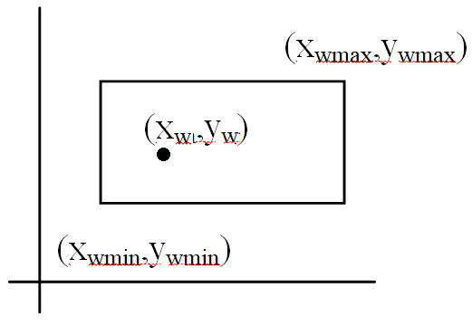
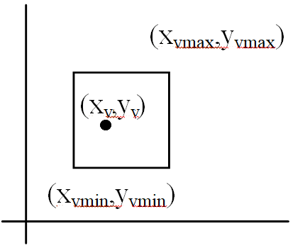
Window to Viewport Transformation
For displaying one has to convert world coordinates into screen coordinates
This transformation is called viewing transformation
A point in position(x_{w},y_{w}) in window is mapped into position (x_{v,} y_{v}) in the viewport
To maintain same relative placement in view port as in window we require,
Window Viewport
Viewport
Computer Graphics, Nepal College of Information Technology, 2009
54

Slide 55
Window to Viewport Transformation
x_{v –} x_{vmin =} x_{w –} x_{wmin}
x_{vmax –} x_{vmin} x_{wmax –} x_{wmin}
y_{v –} y_{vmin =} y_{w –} y_{wmin}
y_{vmax –} y_{vmin} y_{wmax –} y_{wmin}
solving equations for view port position (x_{v} , y_{v})
x_{v =} x_{vmin +} (x_{w –} x_{wmin}) (x_{vmax –} x_{vmin}) = x_{vmin +} (x_{w –} x_{wmin}) . s_{x}
(x_{wmax –} x_{wmin})
y_{v =} y_{vmin +} (y_{w –} y_{wmin}) (y_{vmax –} y_{vmin}) = y_{vmin +} (y_{w –} y_{wmin}) . s_{y}
(y_{wmax –} y_{wmin})
Computer Graphics, Nepal College of Information Technology, 2009
55

Slide 56
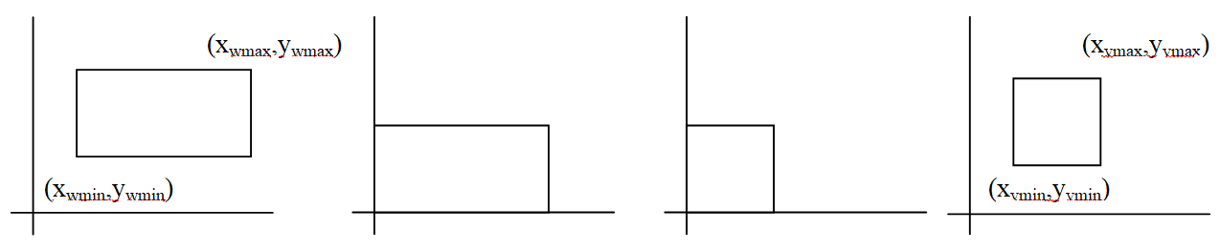
Window to Viewport Transformation (Matrix Form)
Window to View port Transformation (Viewing Transformation)
To transform a window to the view port we have to perform the following steps:
Step1: The object together with its window is translated until the lower left corner of the window is at the origin
Step2: The object and window are scaled until the window has the dimensions of the view port
Step3: Again translate to move the view port to its correct position on the screen
The overall transformation which performs these three steps called the viewing transformation. Let the window coordinates be (x_{wmin}, y_{wmin})and (x_{wmax}, y_{wmax}), view port coordinates be (x_{vmin}, y_{vmin})and (x_{vmax}, y_{vmax})
Computer Graphics, Nepal College of Information Technology, 2009
56

Slide 57
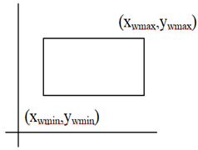
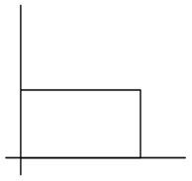
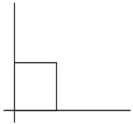
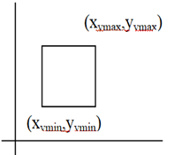
Window to Viewport Transformation (Viewing Transformation)
Therefore the viewing transformation is as follows:
We have to translate the window to the origin by
T_{x} = -x_{wmin} and T_{y} = -y_{wmin}
Then scale the window such that its size is matched to the view port using
S_{x} =(x_{vmax} - x_{vmin})/(x_{wmax} - x_{wmin}) S_{y} =(y_{vmax} - y_{vmin})/(y_{wmax} - y_{wmin})
3. Again translate it by T_{x} = x_{vmin} and T_{y} = y_{vmin}
All these steps can be represented by the following composite transformation:
CM = T_{v} * S_{wv} * T_{w}
Computer Graphics, Nepal College of Information Technology, 2009
57

Slide 58
Window to Viewport Transformation (Viewing Transformation)
All these steps can be represented by the following composite transformation:
CM = T_{v} * S_{wv} * T_{w}
CM =
Here scaling factors are S_{x} =(x_{vmax} - x_{vmin})/(x_{wmax} - x_{wmin}) S_{y} =(y_{vmax} - y_{vmin})/(y_{wmax} - y_{wmin})
=
1 0 x_{wmin}
0 1 y_{wmin}
0 0 1
s_{x} 0 0
0 s_{y} 0
0 0 1
1 0 -x_{wmin}
0 1 -y_{wmin}
0 0 1
x_{v}
y_{v}
1
_{CM}
x_{w}
y_{w}
1
Computer Graphics, Nepal College of Information Technology, 2009
58

Slide 59
Exercise
A Triangle with vertices A(2,3) B(3,4) C(4,3) in world coordinate space with a window with its lowermost left corner at (10,10) and upper most right corner at (100,100) is required to be mapped to a viewport with its lowermost left corner at (20,20) and upper most right corner at (60,60)
A’B’C’
x_{v} = x_{vmin +} (x_{w –} x_{wmin}) . s_{x} = (12). (4)/(9) = 48/9 =5.--
y_{v=} = y_{vmin +} (y_{w –} y_{wmin}) . s_{y} = (13).(4)/(9) = 52/9 = 5.7
Computer Graphics, Nepal College of Information Technology, 2009
59

Slide 60
Clipping in Raster World
Procedure that identifies those operations of picture that are either inside or outside
The region against which an object is to be clipped is called a clip window.
Depending on application it can be polygons or even curve surfaces.

Slide 61
Clipping in Raster World
Applications
i. Extracting parts of defined scene for viewing
ii. Identifying visible surfaces in three dimension views
iii. Drawing, painting operations that allow parts of
picture to be selected for copying, moving, erasing or duplicating etc.

Slide 62
Line Clipping
Point clipping easy: Just check the inequalities (x_{max} ,y_{max})
x_{min} < x < x_{max}
y_{min} < y < y_{max}
Line clipping more tricky (x_{min} ,y_{min})
(x,y)

Slide 63
Cohen-Sutherland Line Clipping
Divide 2D space into 3x3 regions.
Middle region is the clipping window.
Each region is assigned a 4-bit code.
Bit 1 is set to 1 if the region is to the left of the clipping window, otherwise. Similarly for bits 2, 3 and 4.
4
3
2
1
Top Bottom Right Left

Slide 64
4
3
2
1
Top Bottom Right Left
1001
1000
1010
(x_{wmax}, y_{wmax})
0000
0001
0010
(x_{wmin}, y_{wmin})
0101
0100
0110

Slide 65
Cohen-Sutherland Line Clipping
To clip a line, find out which regions its two endpoints lie in.
Case I
If they are both in region 0000, then it’s completely in.

Slide 66
Cohen-Sutherland Line Clipping TBRL
1001
1000
1010
(x_{wmax}, y_{wmax})
0000
TBRL
0001
0010
(x_{wmin}, y_{wmin})
0101
0100
TBRL
0110

Slide 67
Cohen-Sutherland Line Clipping
Case II
If the two region numbers both have a 1 in the same bit position, the line is completely out.
TBRL
0010 A
1010 B
-------
0000 X AND
-------

Slide 68
Cohen-Sutherland Line Clipping
1001
1000
1010
(x_{wmax}, y_{wmax})
0000
0001
0010
(x_{wmin}, y_{wmin})
0101
0100
0110

Slide 69
Cohen-Sutherland Line Clipping
Case III
If lines can not be identified as completely inside or outside we have to do some more calculations.
Here we find the intersection points with a clipping boundary using the slope intercept form of the line equation

Slide 70
Cohen-Sutherland Line Clipping
1001
1000
1010
TBRL
0001 A
1000 B
-------
0000 AND
-------
(x_{wmax}, y_{wmax})
0000
0001
0010
(x_{wmin}, y_{wmin})
0101
0100
0110
y = y₁ + m (x – x₁)
Where x is set to either x_{wmin} or x_{wmax}

Slide 71
Cohen-Sutherland Line Clipping
For a line with end point coordinates (x₁,y₁) and (x₂, y₂) the y coordinate of the intersection point with a vertical boundary is
y = y₁ + m (x – x₁)
Where x is set to either x_{wmin} or x_{wmax}

Slide 72
Cohen-Sutherland Line Clipping
1001
1000
1010
(x_{wmax}, y_{wmax})
TBRL
0000 A
0100 B
-------
0000 AND
-------
0000
0001
0010
(x_{wmin}, y_{wmin})
0101
0100
0110
x = x₁ + 1/m (y – y₁)
Where y is set to either y_{wmin}

Slide 73
Cohen-Sutherland Line Clipping
Similarly for the intersection with a vertical boundary
x = x₁ + (y – y₁)/m
Where y is set to either yw_{min} or yw_{max}

Slide 74
Cohen-Sutherland Line Clipping
Similarly for the intersection with a vertical boundary
y= y₁ + (x – x₁)m
Where X is set to either Xw_{max}
1001
1000
1010
(x_{wmax}, y_{wmax})
0000
0001
0010
(x_{wmin}, y_{wmin})
0101
0100
0110

Slide 75
Cohen-Sutherland Line Clipping
1001
1000
1010
(x_{wmax}, y_{wmax})
0000
0001
0010
(x_{wmin}, y_{wmin})
0101
0100
0110

Slide 76
Cohen-Sutherland Line Clipping In Detail

Slide 77
Cohen-Sutherland Line Clipping
It is based on a coding scheme, makes clever use of bit operations to perform this test efficiently
For each endpoint of a line, a 4 bit binary code is used
Lower order (Bit 1) is set to 1 if the end point is at the left side of the window otherwise set to 0
Bit 2, is set to 1 if the end point is at the right side of the window otherwise set to 0
Bit 3, is set to 1 if the end point is at the bottom of the window otherwise set to 0
Bit 4, is set to 1 if the end point is above the window otherwise set to 0
By numbering bit positions in region code as 1 – 4 from right to left coordinate regions can be correlated with bit positions as
Bit 4 Bit 3 Bit 2 Bit 1
x x x x
up bottom right left
Value of 1 in any bit position indicates that the point is in that relative position otherwise bit position is set to 0.
# if point is within clipping rectangle, region code is 0000.
# if point is below and to the left of rectangle then region code is 0101.

Slide 78
Cohen-Sutherland Line Clipping
1001
1000
1010
(x_{wmax}, y_{wmax})
0000
0001
0010
(x_{wmin}, y_{wmin})
0101
0100
0110

Slide 79
Cohen-Sutherland Line Clipping
Algorithm:
Step 1: Establish the region codes for all line end points:
Bit 1 is set to 1 if x < x_{wmin} otherwise set it to 0
Bit 2 is set to 1 if x > x_{wmax} otherwise set it to 0
Bit 3 is set to 1 if y < y_{wmin} otherwise set it to 0
Bit 4 is set to 1 if y > y_{wmax} otherwise set it to 0
Step 2: Determine which lines are completely inside the window and which are completely outside , using the following tests:
a. If both end points of line have region codes 0000 line is completely inside window
b. If the logical AND operation of the region codes of the two end points is NOT 0000 then
the line is completely outside (same bit position of the two end points have 1)

Slide 80
Cohen-Sutherland Line Clipping
1001
1000
1010
(x_{wmax}, y_{wmax})
0000
0001
0010
(x_{wmin}, y_{wmin})
0101
0100
0110

Slide 81
Cohen-Sutherland Line Clipping
Step 3: if both the tests in step 2 fail then the line is not completely inside nor outside . so we need to find out the intersection with the boundaries of the window
slope (m) = (y₂ –y₁)/(x₂-x₁)
a. If bit 1 is 1 then the line interests with the left boundary and y_{i} = y₁ + m * (x – x₁) where x = x_{wmin}
b. If bit 2 is 1 then the line interests with the right boundary and y_{i} = y₁ + m * (x – x₁) where x = x_{wmax}
c. If bit 3 is 1 then line interests with the bottom boundary and x_{i} = x₁ + (y – y₁)/m where y = y_{wmin}
d. If bit 4 is 1 then line interests with the upper boundary and x_{i} = x₁ + (y – y₁)/m where y = y_{wmax}
Here, x_{i} and y_{i} are the x and y intercepts for that line
Step 4: repeat Step1 to Step3 until the line is completely accepted or rejected

Slide 82
Cohen-Sutherland Line Clipping
1001
1000
1010
(x_{wmax}, y_{wmax})
0000
0001
0010
(x_{wmin}, y_{wmin})
0101
0100
0110

Slide 83
Cohen-Sutherland Line Clipping
1001
1000
1010
(x_{wmax}, y_{wmax})
0000
0001
0010
(x_{wmin}, y_{wmin})
0101
0100
0110

Slide 84
Cohen-Sutherland Line Clipping
1001
1000
1010
(x_{wmax}, y_{wmax})
0000
0001
0010
(x_{wmin}, y_{wmin})
0101
0100
0110

Slide 85
Cohen-Sutherland Line Clipping
Use Cohen Sutherland line clipping algorithm to clip a line
with end point coordinates A(5,20) ,B(60,70) against a
clip window with its lower left corner at (10,10) and
upper right corner at (100,100)
Hints:
Find the region code for each end point of the line
Find if it is above, below, left or right of the clip window
Determine the intersection point of the line segment with the boundary

Slide 86
Cohen-Sutherland Line Clipping
Use Cohen Sutherland line clipping algorithm to clip a line with end point coordinates A(5,20) ,B(60,70)
against a clip window with its lower left corner at (10,10) and upper right corner at (100,100)
Step 1: Establish the region codes for all line end points: TBRL
Region code for A Region code for B
5 < 10 True Bit 1 = 1 Left 60 < 10 False Bit 1 = 0
5 > 100 False Bit 2 = 0 Right 60 > 100 False Bit 2 = 0
20< 10 False Bit 3 = 0 Bottom 70< 10 False Bit 3 = 0
20 > 100False Bit 4 = 0 Top 70> 100 False Bit 4 =0
TBRL
So, Region code for A(0001)
Region code for B(0000)
(100,100)
0000
B(60,70)
A(5,20)
(10,10)

Slide 87
Cohen-Sutherland Line Clipping
Region code for A() Region code for B()
Step 2: Determine which if the line is completely inside the window and or is completely outside:
a. both end points of line DON’T have region codes 0000 so the line is NOT completely inside window false
b. Perform Logial AND operation of region codes of two line end points
Region code for A 0001
Region code for B 0000
AND 0000
Logical AND operation of the region codes of the two end points yields 0000 so it is the case of partial visibility(The line end point A is towards the left side of clip window and the line end point B is inside the clip window)
(100,100)
0000
A’(10,?)
B(60,70)
A(5,20)
(10,10)

Slide 88
Cohen-Sutherland Line Clipping
Use Cohen Sutherland line clipping algorithm to clip a line with end point coordinates A(5,20) ,B(60,70)
against a clip window with its lower left corner at (10,10) and upper right corner at (100,100)
Step 3: Both the tests in step 2 failed so line is not completely inside nor outside . so we need to find out the intersection with the boundaries of the window
slope (m) = (y₂ –y₁)/(x₂-x₁) = 0.91
In case of line end point A(5,20) x₁ = 5 y₁ = 20 TBRL
a. bit 1 is 1 then the line interests with the LEFT boundary
so x = x_{wmin} = 10
y_{i} = y₁ + m * (x – x₁)
y_{i} = 20+ 0.91*5= 24.54
So end point coordinates of line with endpoints A(5,20) ,B(60,70) after clipping : A’(10,25) ,B’(60,70)
(100,100)
0000
B(60,70)
A’(10,25)
A(5,20)
(10,10)
Notes:
y_{i} = 20 + 0.91 * (10 – 5) = 24.5

Slide 89
Cohen-Sutherland Line Clipping
Use Cohen Sutherland line clipping algorithm to clip a line with end point coordinates A(105,30) ,B(55,40)
against a clip window with its lower left corner at (10,10) and upper right corner at (100,100)
Step 1: Establish the region codes for all line end points:
Region code for A Region code for B
105<10 False Bit 1 =0 Left 55< 10 False Bit 1 = 0
105> 100 True Bit 2 =1 Right 55> 100 False Bit 2 = 0
30< 10 False Bit 3 = 0 Bottom 40< 10 False Bit 3 = 0
30> 100 False Bit 4 = 0 Top 40 > 100 False Bit 4 = 0
Region code for A(0010) Region code for B(0000)
bit 2 is 1 then the line interests with the RIGHT boundary
so x = XWMAX = 100
y_{i} = y₁ + m * (x – x₁)
y_{i} =30 + m *(100 -105) = 31
(100,100)
B(55,40)
A’(100,31)
A(105,30)
(10,10)

Slide 90
Cohen-Sutherland Line Clipping
Clip a line with end point coordinates A(-1,6) B(5,-8) against a clip window with its lower left corner at
( -2,-5) and upper right corner at (4,8) using Cohen-Sutherland algorithm.
Step 1: Establish the region codes for all line end points:
Region code for A Region code for B
-1<-2 False Bit 1 = 0 Left 5<-2 False Bit 1 = 0
-1> 4 True Bit 2 = 0 Right 5> 4 False Bit 2 = 1
6< -5 False Bit 3 = 0 Bottom -8< -5 False Bit 3 = 1
6> 8 False Bit 4 = 0 Top -8> 8 False Bit 4 = 0 0101 0100 0110
Region code for A( 0000 ) Region code for B(0110) TBRL
Step 2: Perform Logical AND operation of region codes of line end points yields 0000 partial visibility
bit 2 ,3 and bit is then line interests with right then bottom boundary
Step 3: Find intersection points of the line with window boundaries
so x = x_{wmax} = 4 y = y_{wmin} = -5
y_{i} = y₁ + (x – x₁)*m = -8 + 2.32 = -5.7 x_{i} = 4 + 0.7/-2.33
x_{i} = 4 x_{i} =
5.- -5.6 5.4 -5
0000

Slide 91
Polygon Fill-Area Clipping
v1
v1’
v1”
v3’
v3
v3”
v2
v2
Note: Need to consider each of 4 edge boundaries

Slide 92
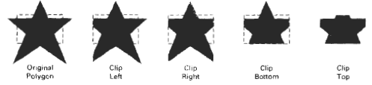
Sutherland-Hodgman Polygon Clipping
Process polygon boundary as a whole against each (clip) window edge
Take initial set of polygon vertices, clip the polygon against, left , right, bottom and top boundary clipper.
At each step, a new sequence of output vertices is generated and passed to the next window boundary clipper

Slide 93
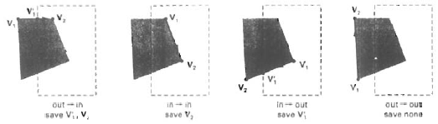
Sutherland-Hodgman Polygon Clipping
Four possible cases when processing vertices in sequence around perimeter of a polygon:
As each pair of adjacent polvgon vertices is passed to a window boundary clipper, we make the following tests:
Case 1: If the first vertex is outside the window boundary and the second vertex is inside, both the intersection point of the polygon edge with the window boundary and the second vertex are added to the output vertex list.
Case 2: If both input vertices are inside the window boundary, only the second vertex is added to the output vertex list.
Case 3: If the first vertex is inside the window boundary and the second vertex is outside, only the edge intersection with the window boundary is added to the output vertex list.
Case 4: If both input vertices are outside the window boundary, nothing is added to the output list.
Once all vertices have been processed for one clip window boundary, the output list of vertices is clipped against the next window boundary.

Slide 94
Sutherland-Hodgman Polygon Clipping: Four possible scenarios at each clipper
outside inside
outside inside
outside inside
outside inside
v2
v2
v2
v2
v1’
v1’
v1
v1
v1
v1
Outside to inside:
Output: v1’ and v2
Inside to inside:
Output: v2
Inside to outside:
Output: v1’
Outside to outside:
Output: nothing

Slide 95
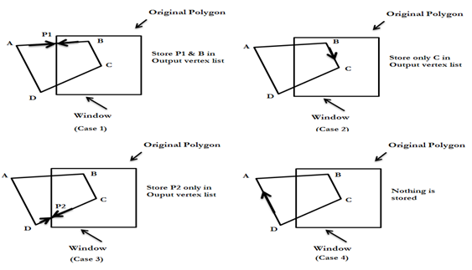
Sutherland-Hodgman Polygon Clipping

Slide 96
Sutherland-Hodgman Polygon Clipping
v2’
v2
Figure 6-27, page 332
v3
v1’
v3’
Left
Clipper
Right
Clipper
Bottom
Clipper
Top
Clipper
v1
v1v2
v2
v2v2’
v2’
v2’v3’
v2”
v2”v1’
v1’
v2v3
v2’
v2’v3’
v3’
v3’v1
v1’v2
v2
v3v1
v3’v1
v3’v1
v1
v1v2
v1’v2
v2v2’
v2’
v1v2
v2
v2v2’
v2’
v2’v2”
v2”
Edges Output
Edges Output
Edges Output
Edges Output
Final

Slide 97
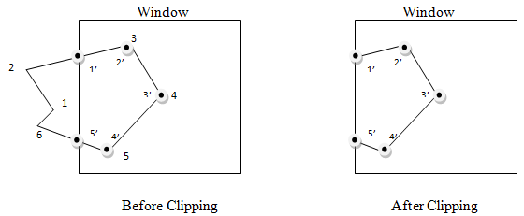
Steps
Process area in figure against left window boundary .
a. Vertices 1,2 are outside of boundary
Moving along to vertex 3 which is inside calculate the intersection . Save both intersection point and vertex 3
c. Vertices 4 and 5 are determined to be inside save them both
d. Vertex 6 is outside so find intersection point so save the intersection point.
Required setting up storage for an output list vertices as a polygon is clipped against each window boundary
The final set of vertices of the clipped polygon are 1’ 2’=3 3’=4 4’=5 5’

